Slide 1
Neuro-Symbolic Program Corrector for Introductory Programming Assignments
ICSE 18
Sahil Bhatia, Pushmeet Kohli, Rishabh Singh
2020-05-14
JuHyoung Kim
kjhkjh75@naver.com

Slide 2
Introduction.
Use the set of student submissions without syntax errors to learn a model of token sequences
Use RNN to learn the token sequence model that can learn large contexture dependencies.
Use constraint-based program
Use SKETCH solver to find minimal changes becomes functionally equivalent to a reference implementation

Slide 3
Introduction.
Novelty
Use a language model learnt from syntactically correct programs to fix syntax errors
Learn a RNN that can more complex dependencies than n-gram or logbilinear neural network
Generate more precise repairs for different problems.

Slide 4
Introduction.
Consider two types of parsing errors in python programs
1. syntax errors
2. indentation errors
Use python compiler to locate the potential error locations
Algorithm enumerates subsequences of predicted sequence in a ranked order to generate proposals.
Compiler is not able to accurately locate the exact location for syntax errors.
-> algorithm ignores present tokens considers the prefix previous line.
Neural network perform the prediction of next k tokens after prefix sequence.
Notes:
알고리즘은 오류 위치에서 삽입 또는 교체를 위한 제안서를 생성하기 위해 순위에 따라 예측 시퀀스의 반복을 열거한다.

Slide 5
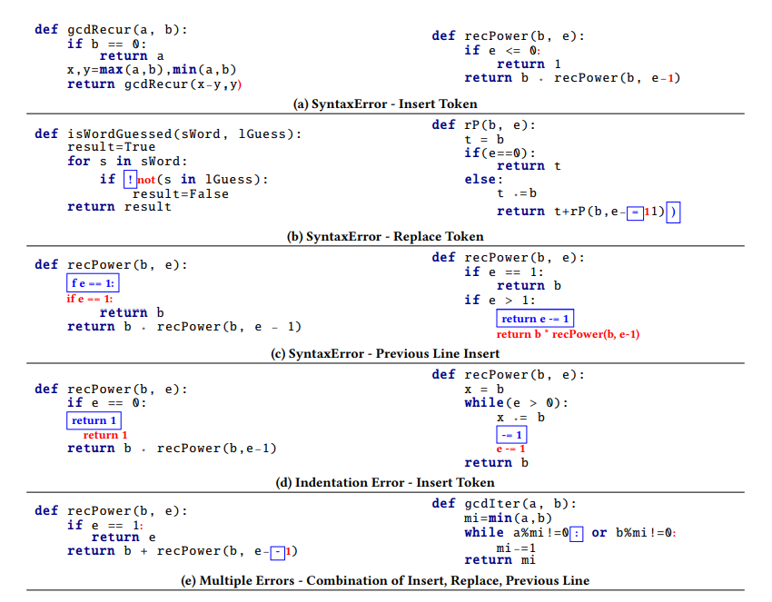
Notes:
a 같은 경우는 괄호나 부분으로 표시된걸 삽입해서 완성시키는 문법오류
(b)같은 경우는 잘못된부분 대체 하는부분
c같은경우는 잘못 입력된 스펠링이나 잘못표현된 부분을 전체 대체한다.
컴파일러는 항상 에러위치를 정확하게 말해주지 못하기 때문에
에러가 나오는 이전 라인을 모델에 넣어서 새라인으로 끝나는 토큰 시퀀스를 예측

Slide 6
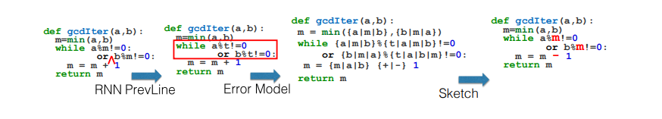
The fixes may or may not correspond to the correct semantic fix
Use SKETCH solver to compute minimal modification becomes equivalent teacher`s implementation.
Notes:
이 모델 같은경우는 컴파일러로 에러위치가 파악이 되지 않아 rnn모델 사용해서 전체라인 예측한 것인데 SKETCH solver 를 통해

Slide 7
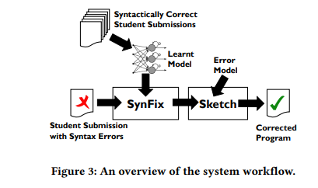
Use the set of all syntactically correct submissions to learn a generative token sequence.
Use SynFix algorithm to find small syntactic corrections
Use the SKETCH synthesis to find minimal modification.

